Slide 1

Relational and Non- relational Databases.
26/08/2024

Slide 2
Content
Introduction
Characteristics
Use cases
Advantages
Conclusion

Slide 3

Introduction

Slide 4
Brief introduction to databases and their importance in data management.
A database is a structured collection of data stored electronically and managed by a Database Management System (DBMS). Databases are essential for organizing, storing, and retrieving large amounts of data efficiently.
They ensure data integrity, consistency, and security, allowing multiple users to access and update data simultaneously. Databases also support scalability, making it easy to handle growing data needs, and offer backup and recovery options to prevent data loss.
In essence, databases are fundamental to effective data management and are crucial for informed decision-making in organizations.

Slide 5
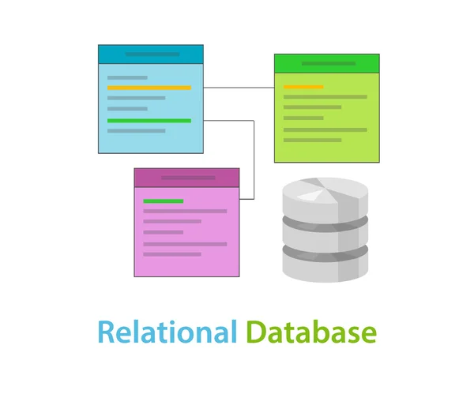
What is a Relational Database?
A relational database is a type of database that stores data in a structured format using tables, which are composed of rows and columns. Each table represents a specific entity, and the relationships between tables are defined through keys, such as primary keys and foreign keys.
Examples of Relational Databases
MySQL
PostgreSQL
Oracle Database
These databases are widely used for their reliability, scalability, and ability to handle complex queries across large datasets.

Slide 6
Characteristics of Relational Database
Structured Data: Data is organized into tables with predefined schemas, making it easy to query and manage.
Use of SQL: Structured Query Language (SQL) is used to interact with the database, allowing for efficient querying, updating, and managing of data.
ACID Properties:
Atomicity: Ensures that transactions are completed fully or not at all.
Consistency: Guarantees that a transaction brings the database from one valid state to another.
Isolation: Ensures that transactions occur independently without interference.
Durability: Once a transaction is committed, it is permanently recorded, even in the event of a system failure.

Slide 7

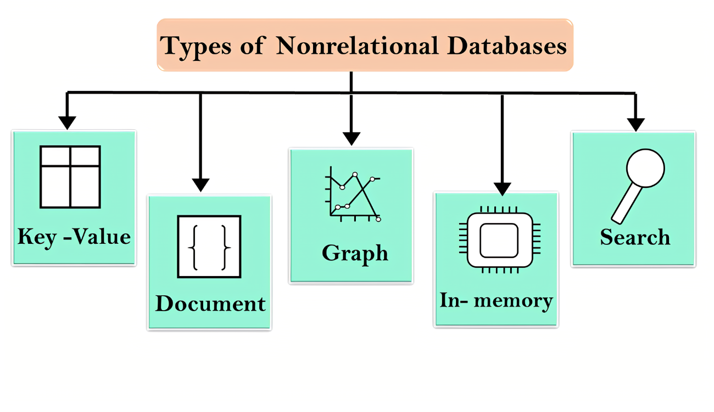
What is a Non-Relational Database ?
A non-relational database is a type of database that stores data in formats other than the traditional table-based structure used in relational databases. These databases are often referred to as NoSQL databases and are designed to handle unstructured or semi-structured data.
Examples of Non-Relational Databases
MongoDB (Document Store)
Cassandra (Wide-Column Store)
Redis (Key-Value Store)
These databases are ideal for handling large volumes of data that don't fit neatly into a table format, providing scalability, flexibility, and performance in various use cases, such as big data, real-time analytics, and distributed systems.

Slide 8
Characteristics of a Non-Relational Database
Unstructured or Semi-Structured Data: Non-relational databases can store data in a variety of formats, including documents, key-value pairs, graphs, and wide-column stores, making them flexible for diverse data types.
NoSQL: Unlike SQL-based relational databases, non-relational databases use different query languages, depending on the data model.
BASE Properties:
Basically Available: The system guarantees availability, even in the presence of some failures.
Soft State: The state of the system may change over time, even without input, due to eventual consistency.
Eventual Consistency: The system eventually reaches consistency, but it may not be immediate.

Slide 9
Key Differences Between Relational and Non-Relational Databases
Data Structure:
Relational Databases: Data is stored in tables with rows and columns. Each table is structured with a predefined schema, making it ideal for highly structured data.
Non-Relational Databases: Data is stored in more flexible formats such as documents, key-value pairs, graphs, or wide-column stores, allowing for the storage of unstructured or semi-structured data.
Query Language:
Relational Databases: Use SQL (Structured Query Language) for querying and managing data, which is standardized across different relational database systems.
Non-Relational Databases: Use various NoSQL languages or APIs tailored to the specific data model (e.g., JSON queries for document stores, CQL for Cassandra).
Schema:
Relational Databases: Have a fixed schema that defines the structure of the data (e.g., data types, table relationships) before any data is entered.
Non-Relational Databases: Support a dynamic schema, allowing the structure to evolve over time without the need for predefined schemas, providing more flexibility in handling different data types.

Slide 10
Use Cases
Use Cases for Relational Databases
Examples:
Financial Systems: Banking applications, accounting software, and transaction processing systems require high levels of accuracy and consistency.
ERP Systems: Enterprise Resource Planning systems integrate various business processes like inventory, HR, and procurement into a single system.
CRM Systems: Customer Relationship Management systems manage customer data, track interactions, and support customer service operations.
Use Cases for Non-Relational Databases
Examples:
Big Data Applications: Handling large volumes of unstructured or semi-structured data, such as social media feeds or IoT sensor data.
Real-Time Analytics: Processing and analyzing data in real-time, such as stock trading platforms or recommendation engines.
Content Management Systems: Storing and managing a wide variety of content types, including documents, media files, and metadata.

Slide 11
Advantages
Advantages of Relational Databases
Data Integrity: Ensures accurate and consistent data through enforced rules like primary keys and foreign keys.
Ease of Use: Standardized SQL makes it straightforward to query, manage, and update data across different relational database systems.
Strong Consistency: ACID properties guarantee that all transactions are processed reliably and consistently.
Support for Complex Queries: SQL supports intricate queries, joins, and aggregations across multiple tables, making it ideal for complex data relationships.
Advantages of Non-Relational Databases
Scalability: Easily scales horizontally by distributing data across multiple servers, making it ideal for large-scale applications.
Flexibility: Dynamic schemas allow for easy adaptation to changing data structures and types, supporting agile development.
High Performance: Optimized for fast data retrieval and processing, even with large and diverse datasets.
Ability to Handle Diverse Data Types: Supports a wide range of data formats, including documents, key-value pairs, graphs, and more, making it versatile for various use cases.

Slide 12

Case Study 1
Example: How a Company Uses a Relational Database for Transactional Data
A leading e-commerce company relies on a relational database (e.g., MySQL) to manage its transactional data. This includes customer orders, payments, inventory management, and shipping details. The relational database ensures data integrity and strong consistency across millions of transactions daily, allowing the company to process payments accurately, track inventory levels in real-time, and maintain customer satisfaction. The use of SQL enables complex queries, such as generating sales reports, monitoring inventory, and analyzing customer purchase patterns.

Slide 13
Case Study 2
Example: How a Company Uses a Non-Relational Database for Big Data Analytics
A global social media platform uses a non-relational database (e.g., Cassandra) to handle the massive amounts of data generated by its users. This includes posts, comments, likes, and multimedia uploads. The non-relational database provides scalability and high performance, enabling the platform to process and analyze this big data in real-time. The flexibility of the database allows it to handle various types of unstructured data, supporting the platform's ability to personalize user feeds, deliver targeted ads, and generate insights into user behavior.

Slide 14
Conclusion
Summary:
Relational Databases: Offer data integrity, strong consistency, ease of use, and support for complex queries.
Non-Relational Databases: Provide scalability, flexibility, high performance, and the ability to handle diverse data types.
Final Thoughts:
Choosing the right database depends on the specific needs of the application. Relational databases are ideal for structured data and applications requiring complex queries and strong consistency. In contrast, non-relational databases excel in handling large, diverse datasets, offering flexibility and scalability. Understanding the strengths of each database type is crucial for making informed decisions in data management.

Slide 15

Thank you
Talabi Damilare Hannah
08024514299
damilaretalabi9@gmail.com

